Slide 1
Cost-Aware and Carbon-Aware
Infrastructure Optimization
A machine-learning framework that recommends Apache Spark deployment configurations across AWS and Azure — on runtime, cost, SLA and carbon emissions
Notes:
So my project is titled Cost-Aware and Carbon-Aware Infrastructure Optimization for Multi-Cloud Big Data Processing Pipelines.
Basically, the problem I looked at is this: when someone wants to run an Apache Spark workload in the cloud, they have to choose the infrastructure before they know how that infrastructure will perform.
So they need to choose things like the cloud provider, the region, the machine type, and the number of nodes. But the runtime, the cost, and even the carbon impact are only known after the job actually runs.
So what I built is a machine-learning-based framework that predicts the runtime and cost of Spark workloads across AWS and Azure. Then, based on those predictions, it recommends suitable cloud configurations by considering cost, runtime, SLA, and carbon emissions.
One important point is that this project is based on 1,811 real measured cloud executions, not only simulation. These runs cover two cloud providers, four regions, twelve machine types, and twenty-one workload and dataset-size scenarios.

Slide 2
THE PROBLEM
Choosing the infrastructure before you can know its cost
Before a Spark job runs, an engineer must fix provider, region, instance type and node count.
That single choice determines cost, completion time and emissions — none of which are knowable without running the job first.
Provider calculators require you to already know the configuration and its duration. Optimisation tools require the workload to already be running on that provider.
So the decision is made by guesswork, by habit, or by over-provisioning — and carbon rarely enters it at all.
WHAT PARTICIPANTS SAY THEY WEIGH
76.1%
Infrastructure cost
71.7%
Runtime and performance
67.4%
Carbon / sustainability
84.8%
Deploy across >1 cloud
THIS IS NOT A HYPOTHETICAL PROBLEM
Why these four factors ?
The Guardian, 11 July 2026 — Microsoft, Amazon and Google datacentre carbon emissions in France are now a major problem.
Microsoft Research — Reducing AI's Carbon Footprint — names one of its three goals as giving developers “tools to find appropriate tradeoffs between performance and carbon emissions.”
2
Notes:
So the main problem is infrastructure selection before execution.
Before a Spark job runs, an engineer has to decide the provider, region, instance type, and number of nodes. But actually, the values they care about most, like cost, runtime, and emissions, are not known at that point.
So there is a problem which needs ton be indetified. To choose the best infrastructure, we need to know the runtime and cost. But to know the runtime and cost, we usually need to run the job first.
Cloud pricing calculators help to some extent, but they normally require the user to already know the machine type and expected duration. Similarly, many optimisation tools need many runs before they can recommend a configuration.
So in practice, the decision can become based on guesswork, previous experience, or over-provisioning. And carbon is often not considered properly in that decision.
To support the this, I also used a questionnaire. In that questionnaire, cost was selected by 76.1% of respondents, runtime and performance by 71.7%, and carbon or sustainability by 67.4%. Also, 84.8% said they deploy or work across more than one cloud.
So I used this survey mainly to motivate the decision factors. The main evidence of the project still comes from the 1,811 measured Spark runs. But the survey helped show that the factors I included are actually relevant to practitioners.
The slide also includes industry examples, like recent concern around data-centre emissions and Microsoft Research discussing trade-offs between performance and carbon. So this shows that the problem is not only theoretical; it is also a real cloud sustainability and decision-making problem.

Slide 3
LITERATURE REVIEW · CHAPTER 2
Thirteen systems reviewed. None covers all six capabilities.
REVIEWED SYSTEM
Big data
Cost
Carbon
Multi-cloud
ML
Recommend
[1] Cloud-Native Data Engineering for Big Data Analytics Gupta et al., InCACCT 2025
✓
✓
–
–
–
–
[2] Autonomous Workload Right-Sizing for Multi-Cloud Cost Optimization Mehta, ICAISET 2026
✓
✓
–
✓
✓
✓
[3] Cloud-Based Cost Calculator for Multi-Provider Comparison Sharma et al., NELEX 2026
–
✓
–
✓
–
✓
[4] Carbon-Aware AI Workload Scheduling with Renewable Energy Chopdar et al., ICECONF 2025
✓
~
✓
✓
✓
✓
[5] Towards Carbon-Aware DevOps M. H. L et al., IITCEE 2026
–
~
✓
✓
–
–
[6] Workload Shifting Based on Low Carbon Intensity Periods Tripathi et al., IEEE BigData 2023
✓
✓
✓
~
–
–
[7] Creating an Energy-Aware Cloud Platform Kosuri et al., ICONAT 2025
✓
~
✓
–
✓
✓
[8] Intelligent Assessment Model of Technological Progress on Carbon Zheng, ICDSCA 2021
–
–
✓
–
✓
–
[9] Energy Savings using Green Cloud Computing Geetanjali & Quraishi, ICICICT 2022
~
✓
✓
–
–
–
[10] Autonomous Cost Optimization using AI-Driven Observability Gandikota & Gaddipati, 2022
✓
✓
~
✓
✓
✓
[11] AI/ML-Driven Automation for Predictive Cloud Operations Lakhnakiya, ICAIC 2026
✓
✓
–
~
✓
✓
[12] Optimizing Cloud Computing Environments for Big Data Processing Valivarthi, 2024
✓
✓
~
✓
~
–
[13] Multidimensional Cost Optimization Strategies for Cloud Gaba et al., ICACRS 2023
~
✓
–
~
✓
–
This framework
✓
✓
✓
✓
✓
✓
3
Notes:
So this slide shows where my project fits compared to existing work.
Previous work already solves parts of this problem. For example, CherryPick uses Bayesian optimisation to reduce the number of cloud profiling runs. Ernest uses small sample runs to build a performance model. PARIS uses resource fingerprints to predict performance on virtual machines. Carbon-aware schedulers try to move workloads towards cleaner grids.
But the issue is that most of these approaches focus on only one part of the decision. Some focus mainly on cost, some on runtime, and some on carbon. Very few combine runtime, cost, SLA, and carbon together in a multi-cloud Spark recommendation framework.
So the gap I identified is that there is limited work that uses measured multi-cloud Spark data to recommend infrastructure before execution while considering all these factors together.
So my project tries to fill that gap by combining prediction and recommendation. The model predicts runtime and cost, and the recommendation engine uses those predictions with SLA and carbon accounting to rank configurations.

Slide 4
SCOPE
Aim, questions, and what I claim to have contributed
AIM To design, develop and evaluate a machine learning-based multi-cloud framework that recommends Apache Spark deployment configurations across AWS and Azure by jointly considering execution runtime, infrastructure cost, SLA constraints, regional carbon intensity and renewable energy availability.
1
Can runtime and cost be predicted accurately enough from configuration alone — with zero new profiling runs for a workload the system has not benchmarked at that size?
CONTRIBUTIONS
A measured datset
2
Does a model-driven recommendation beat simple heuristics once a hard SLA deadline is imposed?
1,811 live executions across two providers, four regions, twelve machine types — not simulation.
A leakage-controlled protocol
3
Does computing emissions per run change the deployment decision, relative to ranking regions by grid carbon intensity?
Grouped splitting and grouped CV, so 439 repeated configurations never straddle a train/test boundary.
A counter-intuitive finding
Per-run emissions accounting and grid-intensity ranking select opposite regions.
4
Notes:
So the aim of my project was to design, develop, and evaluate a machine-learning-based framework for recommending Spark deployment configurations across AWS and Azure.
The project mainly asks three research questions.
First, can runtime and cost be predicted accurately enough from workload and infrastructure characteristics?
Second, can the model-driven recommender perform better than simple heuristic methods when an SLA deadline is applied?
Third, does calculating emissions per run change the decision compared with just ranking regions by grid carbon intensity?
In terms of contribution, there are three main ones.
First, I created a measured datadets of 1,811 Spark executions across two cloud providers, four regions, twelve machine types, and multiple workload sizes.
Second, I used a leakage-controlled validation method. This is important because many configurations were repeated, so I used grouped splitting to make sure repeated runs of the same configuration did not appear in both training and testing.
Third, I found that carbon intensity alone can be misleading. When emissions are calculated per run using runtime, power, node count, carbon intensity, and Power Usage Effectiveness, the decision can be different from simply choosing the lowest-carbon grid region.

Slide 5
THE PROPOSED SOLUTION
Five layers — and no benchmark run at inference
1
2
3
4
5
Cloud
Benchmarking
Dataset
Integration
Machine
Learning
Recommendation
Engine
User
Interaction
›
›
›
›
Runs three Spark workloads across instance types and node counts on EMR and Azure VMs
Standardises provider schemas, joins pricing and Electricity Maps data into one table
Preprocesses, trains four regressors under grouped CV, persists the best
Generates candidates, predicts, computes emissions, filters on SLA, ranks by objective
Streamlit app returns a ranked Top-N with a stated reason per row
THE USER SUPPLIES
Dataset size (MB)
Workload class
SLA deadline (min)
Optimisation goal
Top-N
5
Notes:
So this is the overall framework I built.
It has five main layers.
The first layer is cloud benchmarking. Here I ran three Spark workloads across different machine types, regions, and node counts.
The second layer is dataset integration. In this part, I standardised the AWS and Azure results and merged them with pricing data, carbon intensity data, and renewable-energy data.
The third layer is machine learning. I trained four regression models to predict runtime and cost, then selected the best model based on grouped cross-validation.
The fourth layer is the recommendation engine. This is where the system generates candidate configurations, predicts their runtime and cost, calculates emissions, applies the SLA constraint, and ranks them based on the user’s optimisation goal.
The fifth layer is the user interaction layer. I implemented this through a Streamlit dashboard where the user can enter dataset size, workload type, SLA, optimisation goal, and number of recommendations.
The important point is that once the model is trained, the user does not need to run a new benchmark for every decision. The system can score candidate configurations using the trained model.

Slide 6
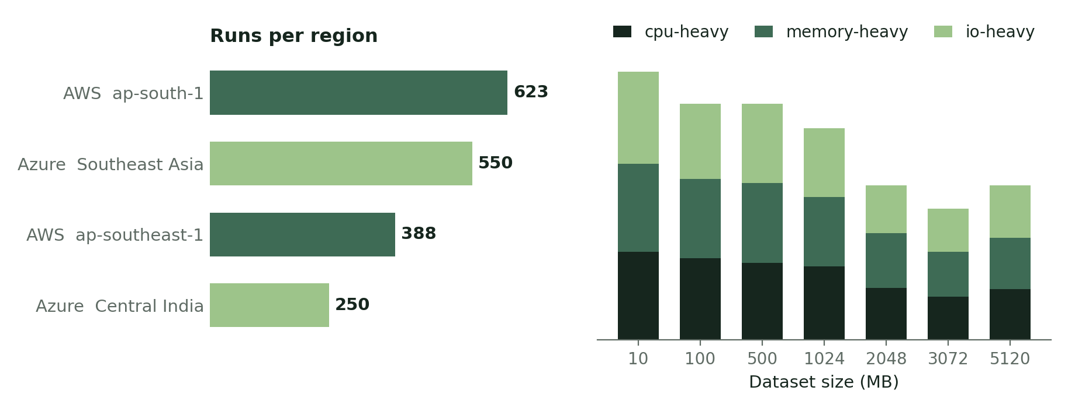
HOW I BUILT IT · 1 OF 4
Building the dataset: 1,811 live cloud executions
THE MATRIX
2 clouds
AWS, Azure
4 regions
ap-south-1 · ap-southeast-1 · Central India · Southeast Asia
12 machine types
6 AWS .xlarge · 6 Azure Standard_D* — disjoint between clouds
2 node counts
2 and 4 workers — isolates the effect of horizontal scaling
THE THREE BENCHMARK WORKLOADS
REPEATABILITY, MEASURED
cpu-heavy
Eight chained sqrt / log1p transformations, then a single grouped aggregation. Narrow transforms, so no shuffle until the groupBy.
439 configurations were run more than once.
memory-heavy
Two cached DataFrames materialised with count(), joined on a 50,000-key space, then aggregated.
A median coefficient of variation of 4.15% confirms the campaign reproduces. Quantifying that variance is what justifies selecting the model on grouped cross-validation rather than on a single partition — the repeated runs are a design feature, not a by-product.
io-heavy
Repartition into 64 partitions, write Parquet, re-read what was just written, write a second summary.
6
Notes:
So this slide explains how I built the actual benchmark dataset.
I created three different Spark workloads.
The first one is CPU-heavy. This workload performs repeated mathematical transformations, such as square root and logarithmic calculations, and then performs aggregation. So this is mainly designed to stress CPU computation.
The second one is memory-heavy. This workload uses cached intermediate DataFrames and joins. So Spark has to keep data in memory and reuse it, which makes memory behaviour important.
The third one is I/O-heavy. This workload repartitions the data, writes it as Parquet, reads it back again, and writes a summary. So this workload stresses read and write operations.
I ran these workloads across AWS EMR and Azure self-managed Spark clusters. The regions were AWS Mumbai, AWS Singapore, Azure Central India, and Azure Southeast Asia.
The matrix also included twelve machine types and two node counts: two nodes and four nodes.
Another important point is repeatability. 439 configurations were run more than once. The median coefficient of variation was 4.15%, which shows that many repeated runs were reasonably stable, but there was still cloud runtime variability.
This is why grouped validation was important. If I used a normal random split, repeated runs of the same configuration could appear in both training and testing, which would make the model look more accurate than it really is.
AWS used EMR, while Azure used self-managed Spark VMs.

Slide 7
HOW I BUILT IT · 2 OF 4
Turning runs into attributable cost and carbon
COST
CARBON
cost_usd = P_hourly × nodes × runtime_hours
emissions_g = (power_W × nodes / 1000)
× (runtime_min / 60)
× carbon_intensity × PUE
AWS cost is the EC2 price plus the EMR service fee, so both providers are costed on a like-for-like basis rather than on bare compute.
Prices fetched once from the AWS Pricing API and Azure Retail Prices API, stored with a fetch date, so results reproduce exactly.
Power draw from published Cloud Carbon Footprint coefficients at a 50% vCPU utilisation assumption; PUE 1.15 AWS, 1.18 Azure.
Grid intensity and renewable share from Electricity Maps: IN-WE 643.3, SG 480.7 gCO₂eq/kWh.
HOW THE COST AND CARBON MODEL IS SCOPED
Attributable
compute cost
Operational
emissions
A uniform
utilisation basis
Cost is computed per execution as hourly price × nodes × runtime. Provider billing aggregates at account level and arrives days later, so it cannot be tied to one run. This figure can be — and it is directly comparable across both providers.
Emissions are computed from the energy drawn during the run, using published hardware coefficients and each provider's PUE. That gives a per-execution figure grounded in measurement rather than an annual average.
A single 50% vCPU utilisation assumption is applied across all 1,811 runs, so every configuration is assessed on identical terms and emissions stay comparable throughout the corpus.
7
Notes:
So after collecting runtime results, I needed to convert them into cost and carbon values.
For cost, I used the hourly price of the machine, the number of nodes, and the measured runtime.
So the basic formula is:
cost equals hourly price multiplied by number of nodes multiplied by runtime in hours.
This gives a per-execution compute cost. It is useful for comparing configurations consistently, but it is not the same as a full cloud bill. For example, it does not fully include every possible storage, network, or account-level charge.
For carbon, I calculated emissions using power draw, node count, runtime, carbon intensity, and PUE.
So basically, I first estimate the energy used by the cluster during the run. Then I multiply that by the regional carbon intensity and the provider PUE.
Carbon intensity and renewable percentage came from Electricity Maps. India regions were mapped to IN-WE, and Southeast Asia regions were mapped to SG.
The important thing is that carbon is not treated only as a regional label. I calculate emissions per run. So the same region can still produce different emissions depending on runtime, node count, and machine power draw.
A limitation is that these emissions are modelled estimates. I did not directly measure physical power consumption from the cloud machines.

Slide 8
HOW I BUILT IT · 3 OF 4
The ML pipeline — and the leakage the grouping prevents
1
Features → targets
Nine features (cloud, region, electricity zone, workload type, machine type, dataset size, nodes, carbon intensity, renewable %) predict two targets: runtime_minutes and cost_usd, via MultiOutputRegressor.
WHY GROUPING IS THE
MOST IMPORTANT LINE OF CODE
439
2
One shared preprocessor
OneHotEncoder on the five categoricals with handle_unknown='ignore'; StandardScaler on the numerics. All four models share one ColumnTransformer, so the comparison is genuinely like-for-like.
configurations in the corpus were deliberately run more than once, to capture runtime variance.
Without grouping, a configuration run three times could put two runs in training and one in test. The model would then be scored on a value it has effectively memorised — interpolation over repeats, dressed up as generalisation.
3
Grouped splitting
GROUP = (cloud, region, dataset_size_mb, workload_type, machine_type, nodes). GroupShuffleSplit for the holdout and GroupKFold for CV keep every run of a configuration on one side of the boundary.
4
Selection on CV, not on one split
So the reported R² ≈ 0.89 is generalisation to configurations never seen in any form.
select_best_model() returns the argmax of cross-validated average R², with cross-validated RMSE as tie-break. The holdout ranking is only a fallback.
8
Notes:
So this slide shows the machine learning pipeline.
The model uses nine input features. These include cloud provider, region, electricity zone, workload type, machine type, dataset size, number of nodes, carbon intensity, and renewable percentage.
The targets are runtime in minutes and cost in USD. Since I predict two outputs at the same time, I used multi-output regression.
For preprocessing, categorical features were one-hot encoded, and numerical features were standard-scaled. I used the same preprocessing pipeline for all models so that the comparison was consistent.
The most important part here is grouped splitting.
Because 439 configurations were repeated, I had to make sure that repeated runs of the same configuration did not appear in both training and testing. So I grouped by cloud, region, dataset size, workload type, machine type, and nodes.
This prevents data leakage. Without grouping, the model could train on one run of a configuration and test on another run of the same configuration. That would not be a real test of generalisation.
So the R2 result is more reliable because the model is being tested on configurations it has not already seen as repeated runs.
One limitation is that carbon intensity and renewable percentage are almost constant per region, so they do not add much independent predictive value to the ML model. They are more important in the recommendation and carbon calculation stage.

Slide 9
HOW I BUILT IT · 4 OF 4
The recommendation engine — candidates in, Top-N out
1
Build candidates
THE BALANCED OBJECTIVE
Distinct (cloud, region, machine type, nodes) tuples observed for that workload — a mean of 32.8, maximum 36, per scenario.
Score = √( 0.35·runtime²
+ 0.35·cost²
+ 0.20·emissions²
+ 0.10·renewable² )
2
Predict
Runtime and cost for every candidate, with a physical-plausibility floor applied before anything reaches the SLA filter.
Each term is a proportional deviation from the best candidate on that criterion — ratio-to-best, not min–max — combined as a weighted Euclidean distance from the ideal point.
3
Compute emissions
Per candidate, from the predicted runtime — carbon enters the decision, not the prediction.
WHY A EUCLIDEAN DISTANCE, NOT A LINEAR SUM
4
Filter on SLA
Min–max normalisation lets candidates that never compete set a criterion's effective weight — runtime can carry 5.7× the influence of cost despite both being weighted 0.35. Ratio-to-best removes that.
A linear weighted sum can only ever select a vertex of the efficient frontier, never an interior compromise.
Squaring before weighting punishes a candidate that is excellent on one axis and poor on another — which is what “balanced” should mean.
Candidates whose predicted runtime exceeds the deadline are dropped. If none meets it, the engine returns the closest alternatives and says so explicitly, rather than an empty result.
5
Score and rank
Cost · Runtime · Carbon · Balanced. Returns Top-N with a stated reason per row.
9
Notes:
So after training the model, I used it inside the recommendation engine.
The user gives the dataset size, workload type, SLA deadline, optimisation goal, and number of results.
The engine first builds candidate configurations from the configurations available in the dataset for that workload type.
Then it predicts runtime and cost for every candidate.
After that, it calculates predicted emissions using the predicted runtime, machine power draw, node count, carbon intensity, and PUE.
Then the SLA filter is applied. If the predicted runtime is higher than the SLA deadline, that candidate is removed. If no configuration meets the SLA, the engine still returns the closest alternatives and clearly states that no option satisfied the SLA.
Finally, the remaining configurations are scored and ranked.
The system supports four goals: cost, runtime, carbon, and balanced.
For balanced optimisation, I combine runtime, cost, emissions, and renewable penalty using weighted scoring. Runtime and cost each get 0.35, emissions get 0.20, and renewable penalty gets 0.10.
These weights are based on judgement and the motivation survey ordering, but I did not run a full sensitivity analysis. So if I had more time, I would test how much the recommendations change when the weights change.

Slide 10
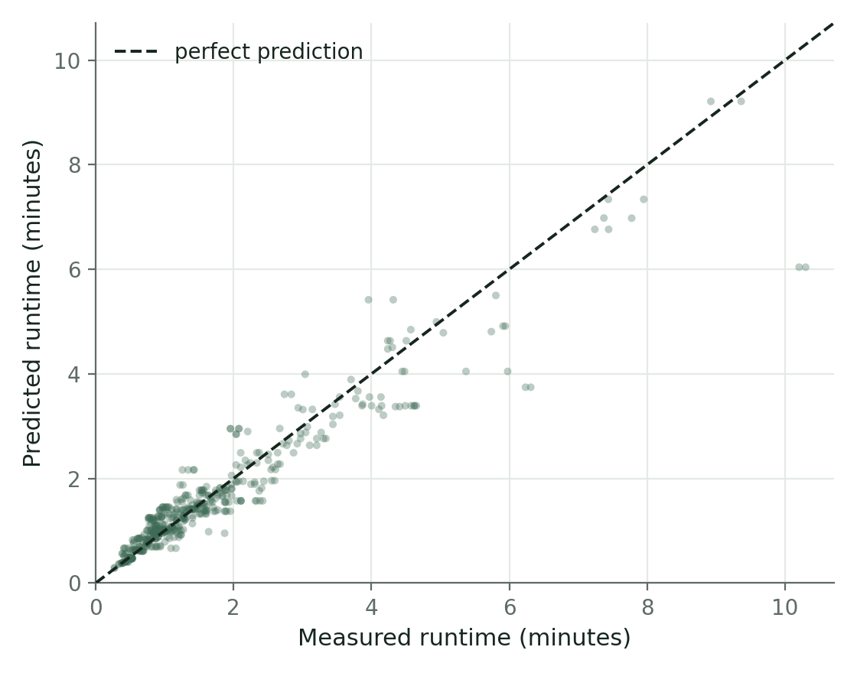
RESULTS · PREDICTION ACCURACY
Can it predict? R² 0.889 ± 0.055 on unseen configurations
GROUPED 5-FOLD CROSS-VALIDATION — THE BASIS OF SELECTION
Model
Runtime R²
Cost R²
Runtime MAE
Linear Regression
0.683 ± 0.031
0.720
0.575
Decision Tree
0.834 ± 0.079
0.808
0.334
Random Forest
0.889 ± 0.055
0.890
0.270
Gradient Boosting
0.885 ± 0.042
0.874
0.285
Selected: Random Forest — leads on all four cross-validated metrics.
WHY RANDOM FOREST
Selection is made on grouped cross-validation, where every configuration is tested exactly once — a far more stable estimate than any single partition.
Both ensembles separate cleanly from Decision Tree (p = 0.0016) and Linear Regression (p = 0.0001) on runtime MAE, and Random Forest leads Gradient Boosting on all four cross-validated metrics.
Deployed Random Forest, held-out group split (n = 493 predictions). Points on the dashed line are exact.
10
Notes:
So this slide shows whether the ML model could actually predict runtime and cost.
I compared four models: Linear Regression, Decision Tree, Random Forest, and Gradient Boosting.
Linear Regression was used as a simple baseline. Decision Tree was used because it can capture non-linear patterns. Random Forest and Gradient Boosting were used because ensemble models usually perform well on structured tabular data.
On the single held-out group split, Gradient Boosting was slightly better. But under grouped five-fold cross-validation, Random Forest performed best across the main metrics.
Random Forest achieved around 0.889 R2 for runtime and 0.890 R2 for cost under grouped cross-validation. Its runtime MAE was about 0.270 minutes, which is around 16 seconds.
So on average, the runtime prediction error was around 16 seconds.
I selected Random Forest because it was more consistent under grouped cross-validation. But I do not claim it is statistically much better than Gradient Boosting. Their results were very close, and the difference was not statistically significant.
So the honest conclusion is that both ensemble models worked well, but Random Forest was the most stable choice in my evaluation.

Slide 11
RESULTS · RECOMMENDATION QUALITY
0.905 top-1 accuracy, and the lowest SLA violation rate
HOW IT WAS EVALUATED
Leave-one-scenario-out across all 21 workload × dataset-size scenarios, against four competing baselines.
For each held-out scenario the model is trained on the remaining twenty, then must rank roughly thirty-three candidate configurations it has never seen at that size — and is scored against ground truth built from the measured runs. Every method faces the same SLA deadline, so the comparison isolates the selection rule itself.
THE RESULT
The model leads every baseline at every SLA level, reaching 0.952 top-1 accuracy with zero SLA violations under a loose deadline. Against the strongest baseline it cuts the SLA violation rate by a third — 0.095 against 0.143.
SLA TIGHTNESS SWEEP — RANDOM FOREST
SLA level
Top-1
SLA violation
Mean cost regret
Tight (25th pct)
0.810
0.143
+16.56%
Medium (50th pct)
0.905
0.095
−0.37%
Loose (75th pct)
0.952
0.000
+1.07%
11
Notes:
So model accuracy alone is not enough for this project, because the final goal is not only prediction. The final goal is decision support.
So I evaluated the recommendation quality using leave-one-scenario-out validation.
A scenario means a workload type and a dataset size. For example, CPU-heavy with 500 MB is one scenario.
For each held-out scenario, the model was trained on the other scenarios. Then it had to rank candidate configurations for the held-out scenario. I compared the chosen configuration against the true best configuration from the measured benchmark data.
I evaluated three SLA levels: tight, medium, and loose. These were based on the 25th, 50th, and 75th percentile of measured runtime for each scenario.
The Random Forest recommender achieved 0.810 top-1 accuracy under tight SLA, 0.905 under medium SLA, and 0.952 under loose SLA. Under loose SLA, there were no SLA violations.
Compared with baselines like historical mean, nearest-size, largest-cluster, and random selection, the model performed best overall.
The important point is that the main advantage is not just lower cost. The stronger advantage is better SLA reliability.
A limitation is that the SLA thresholds were created from measured runtime percentiles. This is useful for controlled evaluation, but in real deployment the SLA should come from the user.

Slide 12
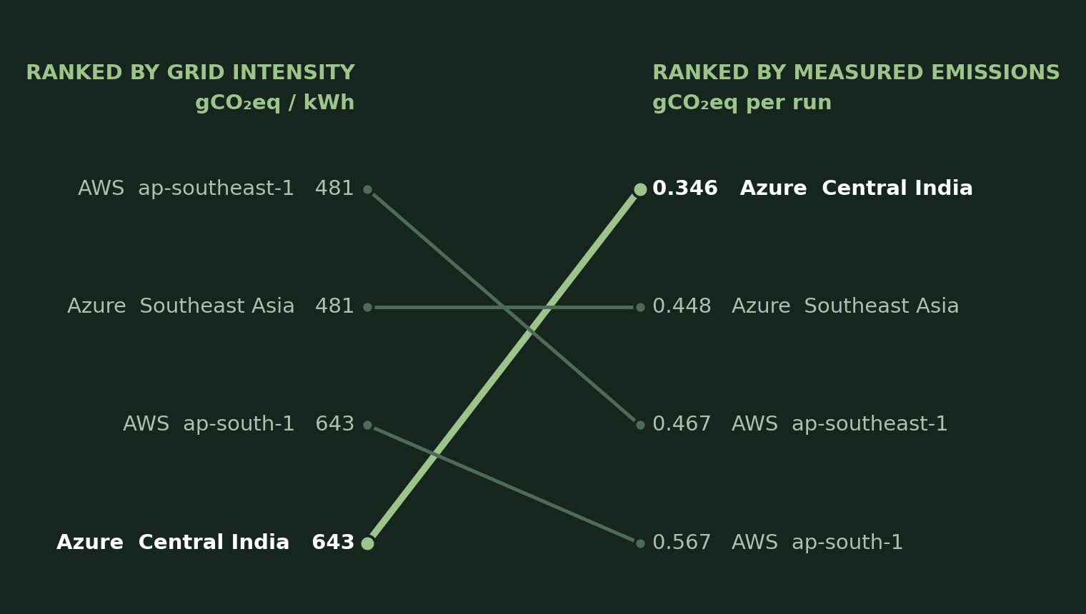
THE HEADLINE FINDING
Ranking regions by grid intensity gives the wrong answer
WHAT IT SHOWS
Ranking regions by grid carbon intensity would select Singapore in all 21 scenarios. Computing emissions per run — power × nodes × runtime × intensity × PUE — selects Azure Central India, at 0.346 against 0.448 gCO₂eq. Grid intensity is not a safe proxy for what a deployment actually emits.
WHY IT MATTERS
Emissions can only be computed from a predicted runtime, so the carbon question and the performance question have to be answered together — which is precisely the case for one integrated framework. And on this corpus the cheapest configuration was also the greenest in 21 of 21 scenarios: optimising for cost did not cost sustainability.
WHAT COMES NEXT
Workload fingerprinting from Spark event-log metrics, so the system characterises a job automatically instead of asking the user to classify it. Then uncertainty-aware SLA filtering — quantile or conformal prediction intervals — which opens the door to spot pricing under a hard deadline.
Mean per-run emissions, 1,811 executions. Grid intensity would select Singapore in 21 of 21 scenarios; per-run accounting selects Azure Central India.
12
Notes:
So this is the main carbon-related finding of the project.
If we only look at grid carbon intensity, Singapore appears cleaner than India, because Singapore has lower grid intensity.
But when I calculated per-run emissions, Azure Central India had lower mean emissions in the dataset.
This is because emissions do not depend only on grid intensity. They also depend on runtime, node count, machine power draw, and PUE.
So the key finding is that grid intensity alone is not a safe proxy for deployment emissions. To make carbon-aware recommendations, we need to combine carbon data with performance prediction.
Another interesting result is that in my corpus, the cheapest configuration was also the greenest in all 21 scenarios. I do not claim this will always happen. In my dataset, this happened because both cost and emissions were strongly driven by node-hours.
So the conclusion is that performance, cost, and carbon should not be treated separately. They need to be evaluated together in one framework.
If I continue this work, I would add workload fingerprinting using Spark event logs and uncertainty-aware SLA filtering, so the system can handle risk more explicitly.
Final Closing
So to conclude, this project shows that Spark runtime and cost can be predicted from measured multi-cloud benchmark data, and those predictions can support practical infrastructure recommendations.
The framework considers cost, runtime, SLA, and carbon together, rather than treating them separately.
At the same time, the work has clear limitations. The dataset size is limited, carbon emissions are modelled rather than directly measured, and the model generalises only within the tested workload and infrastructure scope.
But overall, the project provides a measured and reproducible foundation for cost-aware and carbon-aware infrastructure selection for Spark-based big-data workloads.

